Slide 1
Unstructured Data
Frank Yu Australian Bureau of Statistics

Slide 2
What I will cover in this talk
What unstructured data is and its value for official statistics
The challenges that it presents statistical production
What the ABS is doing to progress capability in this area

Slide 3
Features of “unstructured” data
Does not reside in traditional databases and data warehouses
May have an internal structure, but does not fit a relational data model
Generated by both humans and machines
Textual and multimedia content
Machine-to-machine communication
Examples include
Personal messaging – email, instant messages, tweets, chat
Business documents – business reports, presentations, survey responses
Web content – web pages, blogs, wikis, audio files, photos, videos
Sensor output – satellite imagery, geolocation data, scanner transactions

Slide 4
The value of unstructured data sources
Provide a rich source of information about people, households and economies
May enable the more accurate and timely measurement of a range of demographic, social, economic and environmental phenomena
Combined with traditional data sources
As a replacement for traditional data sources
So presents unprecedented opportunities for official statistics to
Improve delivery of current statistical outputs
Create new information products not possible with traditional data sources
ABS believes that the benefit should be demonstrated on a case-by-case basis – the improvement of end-to-end statistical outcomes in terms of objective criteria such as accuracy, relevance, consistency, interpretability, timeliness, and cost

Slide 5
Content analysis
For unstructured data to be useful it must be analysed to extract and expose the information it contains
Different types of analysis are possible, such as:
Entity analysis – people, organisations, objects and events, and the relationships between them
Topic analysis – topics or themes, and their relative importance
Sentiment analysis – subjective view of a person to a particular topic
Feature analysis – inherent characteristics that are significant for a particular analytical perspective (e.g. land coverage in satellite imagery)
Many others
Techniques and tools already exist or being developed …

Slide 6
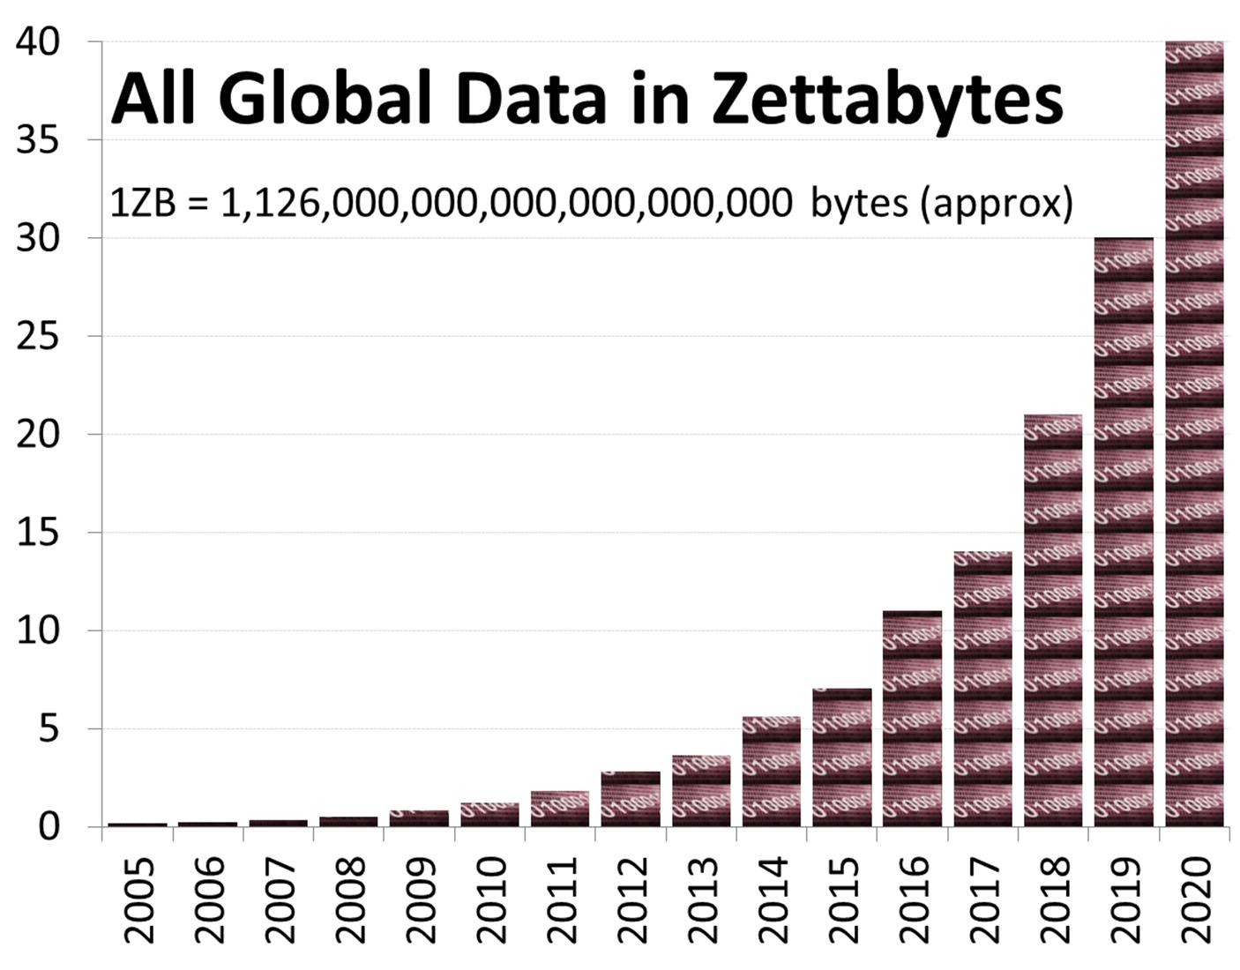
But the scale is mind-boggling
1 ZB = 10²¹ bytes = 1024 Exabytes
About 85% is unstructured data
Notes:
According to IDC’s Digital Universe Study
The world’s “digital universe” is in the process of generating 1.8 Zettabytes of information
With continuing exponential growth this projects to 40 Zettabytes in 2020
Two put this into perspective, 1ZB is 1000 EB or a billion TB.
Five exabytes (10^18 gigabytes) of data would contain all words ever spoken by human beings on earth
The source?
Over 5 billion mobile devices in use worldwide. Each call, text and instant message is logged as data. Mobile devices, particularly smart phones and tablets, also make it easier to use social media and use other data-generating applications. Mobile devices also collect and transmit location data
Billions of internet transactions – purchases, funds transfers, share trades – every day, including countless automated transactions. Each creates a number of data points collected by retailers, banks, credit card issuers, credit agencies and others
Millions of networked electronic devices – including servers and other IT hardware, smart energy meters and temperature and other sensors – all create semi-structured log data that record every action
Hundreds of millions of social networking users and resources. Each Facebook update, Tweet, blog post and comment creates multiple new data points, both structured and unstructured

Slide 7
Big Data
Data sets of such size, complexity and volatility that their business value cannot be fully realised with existing data capture, storage, processing, analysis and management capabilities
The systematic use of unstructured data is a Big Data challenge!
Notes:
Existing computational models for the most common statistical problems very poorly for Big Data problems
In particular, traditional relational database and data warehouse approaches are not sufficiently flexible for handling large unstructured data sets in a computationally efficient way
We need to develop techniques for reducing data volume and complexity while preserving statistical validity, and new techniques for representing, manipulating, visualising and analysing data on a vast scale.

Slide 8
Some other significant challenges
Validity of statistical inference
Sample biases
Model biases
Privacy and public trust
Disclosure threat due to mosaic effect
Data integrity
Missing, inconsistent and inaccurate data
Volatile sources
Data ownership and access
Public good versus commercial advantage
Value of private sector data
Notes:
Validity of Statistical Inference
Data sets derived from Big Data sources are not necessarily random or representative samples of the target population. For example, social media services (such as Twitter) are a rich data source for the measurement of public opinion. However, there is little verifiable information about the users of these services, and it is difficult to determine whether their distribution by sex, age, location and socioeconomic profile is consistent with that of the population in general. In fact, it is to be expected that some population subgroups will be under-represented in any sample of social media data, due to the differential adoption rate of new technologies. Where significant biases exist in the data, derived estimates of population characteristics will not be statistically valid. National statistical organisations (NSOs) are uniquely positioned to assess the nature of bias. In some cases the big data might be supplemented with survey data to get coverage of un-represented segments of the population. In other cases it may be useful to publish statistics that describe sub-populations.
A related issue is that the statistical analysis of large, complex heterogeneous datasets will inevitably yield significantly more spurious model-dependent correlations than would be expected from traditional data sources. This can actually accentuate any modelling bias by reinforcing the selection of the wrong variables, algorithms and metrics of fitness. For example, Google Flu Trends – which uses the number of online searches as a measure of the prevalence of flu in the general population – mistakenly estimated that peak flu levels reached 11% of the US public in the 2012 flu season. This was almost double the correct estimate of 6% produced by public health officials. While Google will not comment on the reason for the overestimation, it seems likely that it was caused by extensive media coverage of the flu season, which created a spike in search queries. NSOs will play a role in helping others assess the accuracy of models and calibrate them.
Privacy and Public Trust
The privacy landscape is fundamentally changed by the emergence of big data. There is an obvious contention between the systematic exploitation of Big Data sources for better decision-making across government, and the acknowledged need to establish and maintain public trust in the use of personal information by government agencies. The ABS does have a framework and relevant legislation (own and the Privacy Act) to set the ground rules for how such data sets can be acquired, combined, protected, shared, exposed, analysed and retained. The framework is designed to promote trust and privacy and big data sources will further test our decision-making in adherence to the framework.
A significant unresolved issue is the threat of disclosure through data accumulation. Every individual is a unique mosaic of publicly visible characteristics and private information. In a data rich world, distinct pieces of data that may not pose a privacy risk when released independently, are likely to reveal personal information when they are combined – a situation referred to in the intelligence community as the “mosaic effect”. The use of Big Data greatly amplifies the mosaic effect because large rich data sets typically contain many visible characteristics, and so individually or in composition enable spontaneous recognition of individuals and the consequential disclosure of their private information. This is a possible issue for the ABS dissemination of microdata sets from Big Data sources, since there is not yet a consistent, methodologically rigorous framework for assessing disclosure risk in terms of the utility of data set for analytical purposes. Currently, ABS does not assess disclosure risk in terms of utility. If there is a disclosure risk then we do not disclose – regardless of the utility of the analysis.
Data Integrity
The ABS has a multi-dimensional Data Quality Framework. Big data will present challenges on each dimension. It will be difficult to describe the quality of statistics produced using non-survey methods. Data integrity broadly covers its quality, provenance and reliability for statistical purposes. Many Big Data sources are inherently ‘noisy’, and will typically need extensive data filtering and repair to deal with inaccuracy, inconsistency and incompleteness. For example, real-time sensor networks are susceptible to sensor malfunction and network latencies, satellite imagery is adversely affected by atmospheric conditions, and social media opinion is invariably contaminated by ambiguity and deception. Existing statistical methods are not tolerant of erroneous data, and there is presently no generalised framework for treating missing and inconsistent data from non-survey sources.
Much Web content is also unstructured and ungoverned – the metadata describing its usage and provenance (origin, derivation, history, custody, and context) are either incomplete or incongruous. Indeed, the long-term reliability of Big Data sources may be an issue for ongoing statistical production. Reputable statistics for policy making and service evaluation are generally required for extended periods of time, often many years. However, large data sets from dynamic networks are volatile – the data sources may change in character or disappear over time. What becomes of time series in a world where data streams and sources are transient?
Data Ownership and Access
Data ownership and access presents as a key issue and one where there is a lack of legislation and a supporting framework. The challenge is to unlock public good from privately collected data where there may be a strong private interest in keeping the data private.
The Big Data opportunity for the ABS spans a vast array of direct sources beyond the government sector, such as commercial transactions (e.g. scanner data from supermarkets), sensors (e.g. satellite imagery), tracking devices (e.g. location-sensitive services associated with mobile devices), and administrative product (e.g. electronic health records). It also includes data derived from the results of analysis on public and private data sets, such as behavioural profiling (e.g. activity analysis of online purchases or credit card transactions), opinion mining (e.g. topic or sentiment analysis of Twitter feeds and on-line searches), and social network analysis (e.g. link and influence analysis of Facebook data).
In many cases, a commercial value is placed on primary and derived non-government data sets by their owners – since either the provision of such data is the basis of their business, or its possession is a significant element of competitive advantage. This raises the issue of how the ABS might acquire commercially valuable or sensitive data for statistical production, particularly if the statistics compete directly with information products created by the data owner or they compromise its market position. This issue is made more complex by the fact that there may be several parties with some form of commercial right in relation to a data set, either through ownership, possession or licensing arrangements.
Computational Efficacy
The exploitation of Big Data will have a significant impact on the ICT resource demands of data acquisition, storage, processing, integration, and analysis. Existing computational models for the most common statistical problems in the ABS scale very poorly for the number, diversity and volatility of data elements, attributes and linkages associated with Big Data sources.
In particular, traditional relational database approaches are not sufficiently flexible for handling dynamic multiply-structured data sets in a computationally efficient way, and the execution of complex statistical algorithms at the scale of Big Data problems is likely to exceed the memory and processor resources of existing platforms. For example, probabilistic data linking under the Fellegi-Sunter model is generally treated as a constrained Maximum Likelihood problem using simplex-based algorithms. The complexity of this problem is at least O(N³), which cannot be solved with existing computing resources when the size of the data set N is at the scale of Big Data.
One likely approach will be to outsource the analytics to the data owner. Statistics NZ is looking to do this with scanner data as the data owner has the necessary infrastructure and performing the analysis where the data is stored is cheaper and easier. An added and important benefit of this approach is that the data owner does not need to share the underlying data which may be very sensitive. A joint effort by methodologist and technologist is needed to develop techniques for reducing data volume and complexity while preserving statistical validity, and for improving algorithmic tractability and efficiency. This will involve explicitly recasting existing problems into a form that is better suited for distributed computing approaches, making greater use of approximate techniques, and favouring heuristic predictive models in the appropriate circumstances.
Technology Infrastructure
Big data technology has emerged from the extreme scale of Internet processing and progressively been applied to a growing range of business domains in the last decade. Industry supported open source technology developments have rapidly matured to the point where ‘enterprise class’ processing in conjunction with traditional processing technologies provide a stronger integrated set of solution choices. Stand-alone and ‘point’ big data solutions are diminishing as they are integrated into wider solution architectures. Most established technology suppliers now include big data technology as part of their product portfolio. Big data infrastructure and tools are evolving and there will continue to be proprietary and point solutions. Big data processing also requires new types of data representation (semantic data, graph database), inference (AI-based analytical techniques in conjunction with robust statistical analysis), visualisation (for complex network relationships), analytical languages (such as R and SAS), and the use of scale-out commodity hardware. A number of these technologies have value when applied to ‘traditional’ processing and analysis.
Where big data capabilities enhance the CSIP solution architecture, these should be included.

Slide 9
ABS work in this area
Established an research program led by Methodology Division to build a sound foundation for the mainstream use of Big Data – particularly unstructured data – in statistical production and analysis
Investigating techniques and technology solutions for future enterprise systems – such as open-source, NSI-source, and commercial software products
Particular areas of interest
Machine learning
Multidimensional data visualisation
Semantic Web methods
Distributed computing

Slide 10
Some key initiatives for 2013-14
Satellite imagery for agricultural statistics – use of satellite sensor data for the production of agricultural statistics such as land use, crop type and crop yield.
Mobile device location data for population mobility – use of mobile device location-based services and/or global positioning for measuring population mobility
Visualisation for exploratory data analysis – advanced visualisation techniques for the exploratory analysis of structured and unstructured data sets
Automated entity analysis of unstructured data –techniques for the extraction and resolution of concepts, entities and facts from text data

Slide 11
Questions?

